Slide 1
Project Presentation on
ONLINE SHOPPING SYSTEM
Sr.No. | Name | Roll No
1 | PANADE AMEY ANIL | 43539
2 | PATIL AMIT MADHUKAR | 43393
3 | SAKHARE NIKHIL NANDKUMAR | 43499
4 | PARTE ASHISH SANTOSH | 43563
Under Guidance
Mrs. Dhanshree Yadav

Slide 2
Project Scope
Purchasing and selling products and services over the internet without the need of going physically to the market is what online shopping all about. Online shopping is just like a retail store shopping that we do by going to the market, but it is done through the internet. Online shopping has made shopping painless and added more fun. Online stores offer product description, pictures, comparisons, price and much more.
Online shopping makes use of digital technology for managing the flow of information, products, and payment between consumer, site owners and suppliers.

Slide 3
Modules
Admin
a. User Management
a.1 Customer (Add, Delete, List, Search)
a.2 Manager/Staff (Add, Delete, List, Search)
a.3 Seller (Add, Delete, List, Search)
b. Category Management
b.1 Add category
b.2 Delete category
b.3 List of categories
c. Product Management
c.1 Approval for product addition
c.2 List of products
c.3 Search for product details (Sort by Product Name; Seller Name; Category )
d. Payment Management
d.1 Staff Salary
d.2 Stock Payment
e. Total Revenue check
f. Edit Profile
g. Analysis
g.1 Rating and reviews
g.2 Feedback analysis
h. Website settings

Slide 4
Store Manager
Stock management
a.1 Add product
a.2 Maintain product details
a.3 Inventory Report
b. Billing of Stock
c. Price and Discount
Edit Profile
List products
List Sellers with their products

Slide 5
Order Manager
Order Management
a.1 Maintain order details
a.2 Return order list
a.3 Order Summery
b. Analysis
b.1 Customer’s wish list
b.2 Customer’s cart
c. Notify best deals to customers according to their wish list
d. Edit Profile
e. Maintain Delivery person details for every order

Slide 6
Customer
Registration
a.1 Sign Up
a.2 Sign In
Search
b.1 Search Product by Name; Category
b.2 Search Categories
Add product to wish list
Add product to my cart
Order
e.1 Details
e.2 History
e.3 Issue order
e.4 Cancel order
e.5 Order Payment
Feedback
f.1 Rating and review
Edit profile
Help
FAQ
About us
Contact us

Slide 7
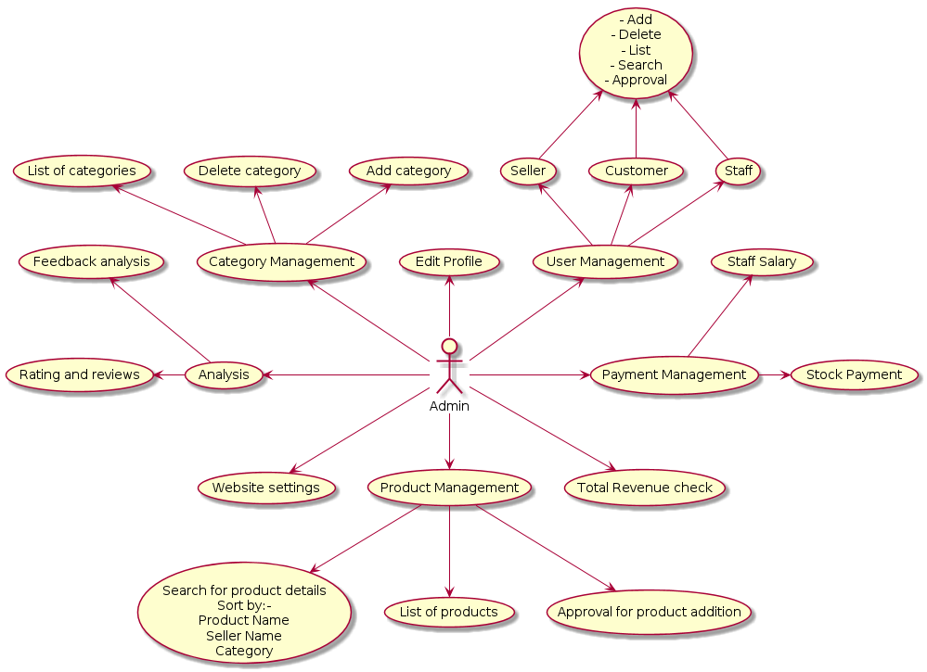
Use_case

Slide 8
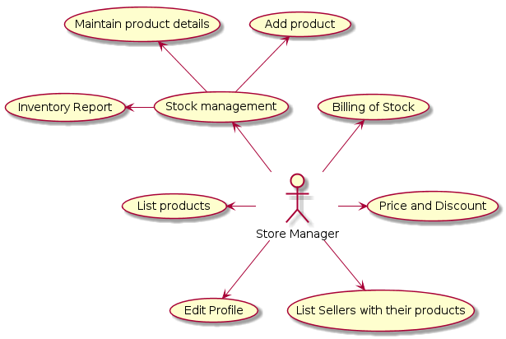

Slide 9
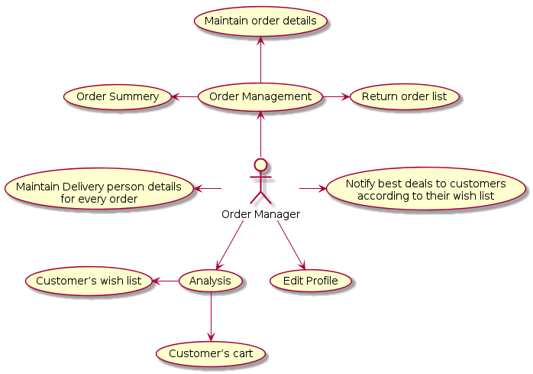

Slide 10
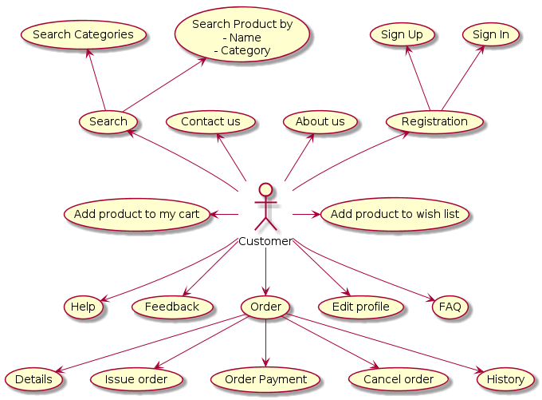

Slide 11
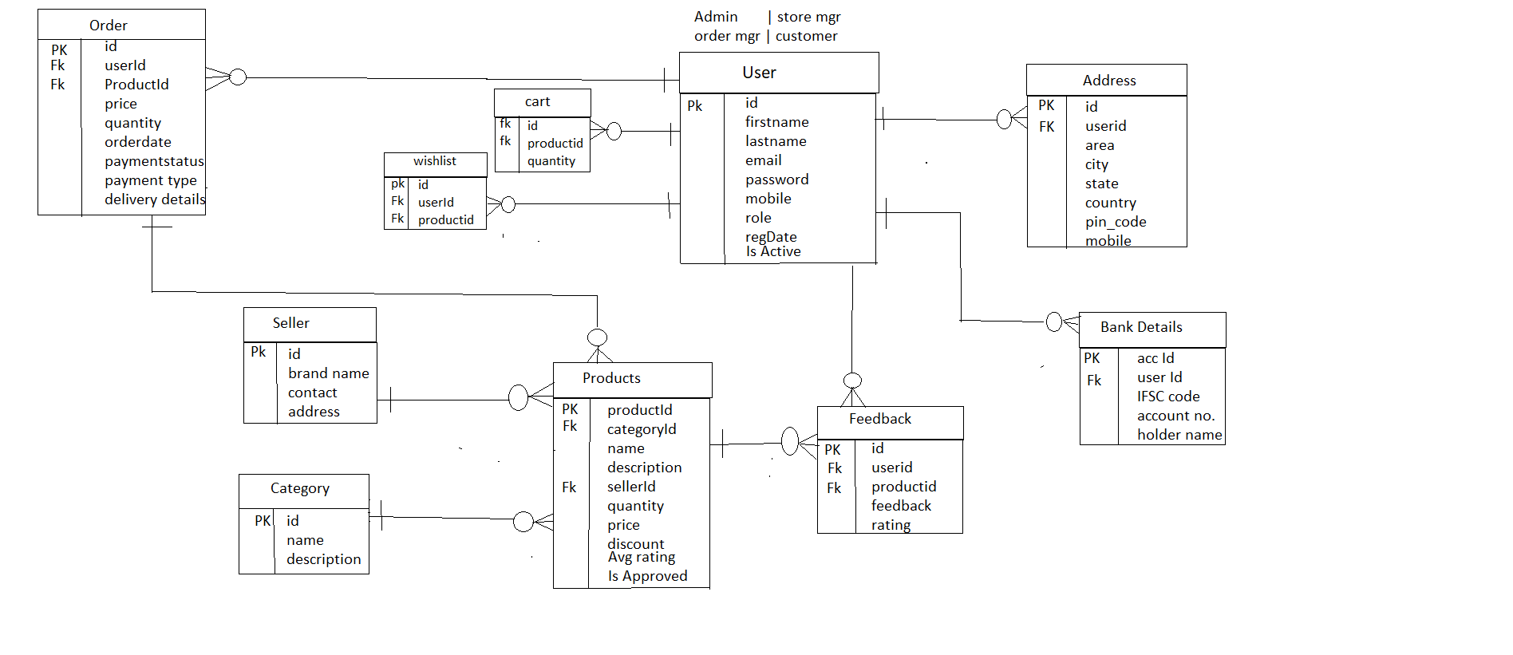
ER Diagram

Slide 12
Thank You.!

